Slide 1

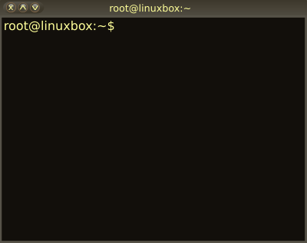

04 – Installing Software
COMP 190 – Dickinson College
Fall 2022
Images from: openclipart.org

Slide 2
Software Installation
Environment Variables
The PATH variable
The Super User
Software Installation
Package Managers
Graphical Interface
Command Line Interface
The Advance Package Tool (APT)

Slide 3
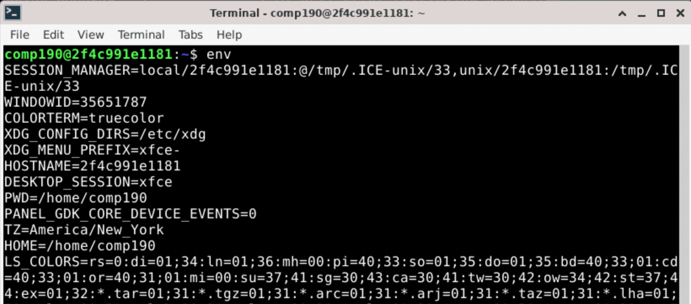
Environment Variables
Environment variables are used by Linux/Unix shells to track information and to customize how the system works.
Notes:
There are some things we need to know about before we get into software installation.
The env command can be used to display all of the defined environment variables.
Each variable has a KEY and a value.
- they are KEY=value pairs
KEY is the variable name
Value is the value of the variable.
We won’t care about most of these… but there are a few that should seem reasonable:
- HOSTNAME= the name of the machine
- for us its that seemingly random string of letters and numbers.
- PWD=/home/comp190
- pwd is the ”present working directory”
- this will change when you use cd.
- HOME=/home/comp190
- This is your home directory.

Slide 4
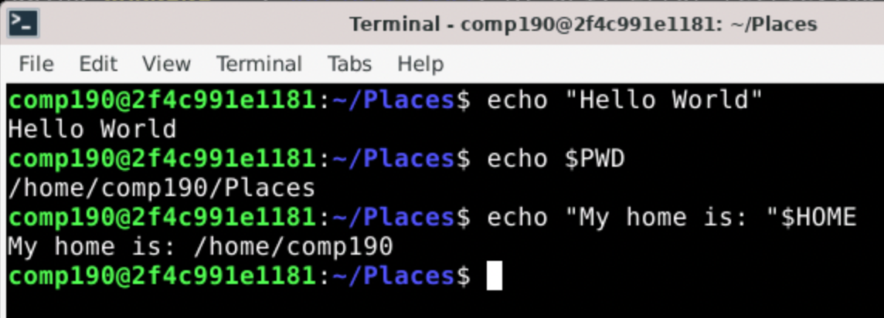
echo and Environment Variables
The echo command is used to write text to standard output.
A $ can be used to access the value of an environment variable (e.g. $HOME)
Notes:
We’ll use echo to look at a few environment variavble.
It is also very useful in shell scripts.
- If you want to display something in a script you use echo.

Slide 5
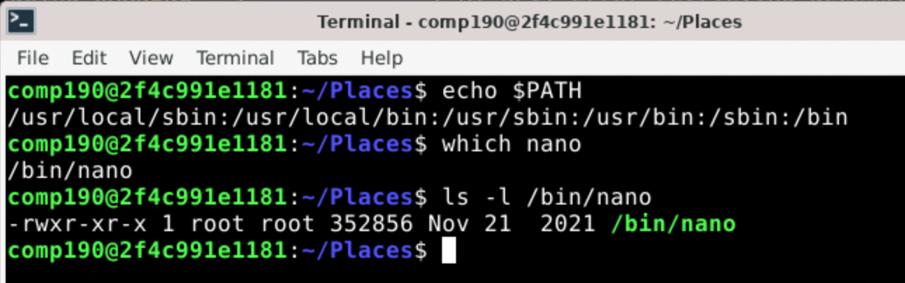
The PATH Environment Variable
The value of the PATH Environment Variable is a : delimited list of absolute paths to directories that the shell searches for executable programs.
Notes:
So when you type the name of a program on the command line (e.g. ls) the PATH is the list of the places that the shell will look for that program.
- here it looks in /usr/local/sbin
- if the program is not found there then it looks in /usr/local/bin
- etc…
The which command will display the absolute path to an executable program file that is found on the PATH.
- It tells you which executable program will run when you type the name of the program.
- For example:
- which nano -> Tells us that the executable nano program is /bin/nano
- because /bin is on the path and that is where then nano program is stored.
If we look at the permissions on the file /bin/nano
- We see it is owned by user root and belongs to group root.
- More on that later
- But we know that’s not us, because we are user comp190 and group comp190
- So we are in the other group.
- Our permissions here are r-x so we can read and execute the program.
- Makes sense since we saw we could run the nano program back in A02.
- This is similar for all of the other commands that we use.

Slide 6
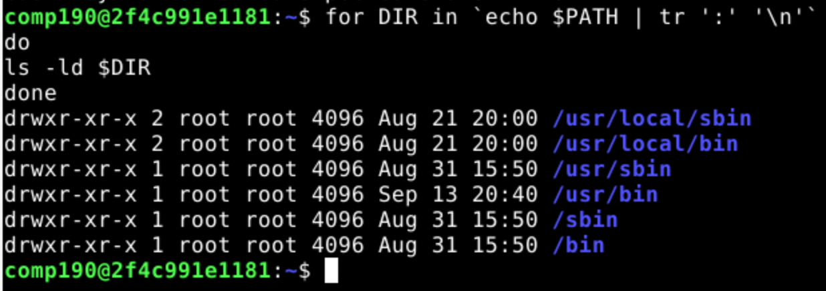
Software Installs & Permissions
All of the directories on the PATH are owned by the user root and belong to the group root.
We do not have write permission to these directories.
Notes:
When new software is installed into the system it is typically installed into the directories listed on the PATH
- That way it can be run just by typing its name on the command line.
- E.g. like nano.
- But…
- We don’t have write permission to any of the directories on the path.
- They are owned by the user root and belong to the group root.
So if we are going to install software, we need to have additional privileges…
Not critical… but if you are interested the command used:
- it is a for-each loop
- DIR takes on the value of the name of each directory in the PATH environment variable
- The loop then uses ls –ld to display the long listing for that directory.
- The echo $PATH outputs the $PATH variable which is piped into the tr filter.
- The tr filter translates ’:’ characters into newline (\n) characters so that there is one directory per line
- That is how the for command expects them.
- the back ticks (`…`) around the echo and tr commands use the output of those commands in that place
- That is, the for-each runs over the list of directories.

Slide 7
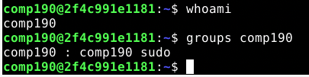
Super User (root) and sudo
Unix is a multi-user system
root is the name of the super user
Permissions checking is disabled
root user cannot log in for security reasons
The sudo command runs commands as the root user.
sudo <command>
Members of the sudo group have sudo privileges
Notes:
A multi-user system means
- multiple accounts
- different users can log into the same system (think servers and shared computers)
- different users will have different permissions
- Don’t want everyone being able to change system settings.
Permission checking is essentially disabled for the root user.
- Can perform any operation on any file.
- For security reasons the root user cannot log in directly.
The sudo command will execute a commands as if it were run by the super user (root).
- Thus using sudo overrides the permission system
- Allows users with permission to use sudo to administer the system.
- So only trusted users (e.g. system administrators) should be in the sudo group.
Permission to sudo is controlled by being a member of the sudo group.
- The comp190 user is a member of the sudo group.
Example:
- If you were setting up a machine for multiple people to use (e.g. in a lab)
- Then your user would be in the sudo group
- But the users you create for others would not be in the sudo group
- They might be in a users, staff or student group,
- Which could then be assigned different privileges

Slide 8
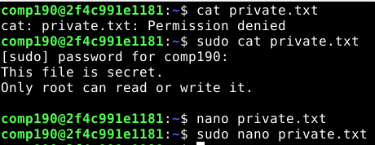

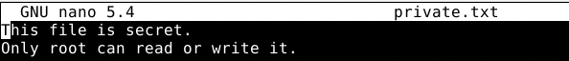
Using sudo
To use sudo, place the command to be run as the Super User on the command line after sudo.
Notes:
Consider the file private.txt
- The owner of this file is root
- root has rw- permissions
- the group (comp190) and anyone else (others) have no permissions ---
- So when the comp190 user tries to cat the file
- permission denied because that user does not have read permission
- even though comp190 belongs to the group comp190 and this file belongs to hat group
- because the group does not have read permission ---
- But when comp190 uses sudo cat private.txt
- the file is displayed because the cat private.txt command is now run as the super user (root)
This works similarly with editing.
- When the user comp190 tries to edit the file using nano
- nano cannot read the file because comp190 does not have permission to do so.
- When the user comp190 uses sudo
- nano can read the file, because nano has been run as the super user (root)

Slide 9
Software Installation
A package manager is a program that uses package repositories to simplify installing, updating and removing software and its external dependencies.
System-Level Package Managers
apt, rpm, yum, pacman, brew, snap
Project-Level Package Managers
JavaScript npm
Python pip conda
Java maven gradle
Notes:
Package Repositories are on-line sites that store installation packages for software.
- This in includes the program itself
- but also information about any external dependencies that the program needs to work.
External dependencies are other programs, tools or libraries that a piece of software being installed requires in order to work correctly.
- It’s like buying something at the store that requires batteries
- But is labeled “batteries not included”
- The batteries are an external dependency
- The package manage keeps track of that
- When you buy that thing that needs the batteries, the dependency manager will automatically also buy the correct batteries.
When a piece of software is installed with a package manager
- That software is installed
- and so are any of the external dependencies that it needs in order to function.
Different Linux Flavors and different OS use different package managers.
Apt – advancd packaging tool
Rpm – redhat package manager
Yum – yellowdog updater – modified
Pacman – archlinux
Brew – macOS
Snap – linux
For now we’ll focus on system software package manager
We will use APT the Synaptic Package Manager
It is a really good one and is what is the default on Debian and a few other flavors.
What we learn about it generalizes to the others pretty easily.
We will not be looking at the project-level package managers in this course.
- May see one in COMP290

Slide 10
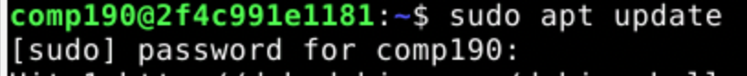
The Advanced Packaging Tool (apt)
The apt is the default package manager in Debian Linux.
Updating package information: sudo apt update
Installing a package: sudo apt install <package>
Searching for packages: apt search <string>
Removing a package: sudo apt remove <package>
Notes:
I pronounce it A P T.
- Some will pronounce it as a word (rhymes with wrapped).
Updating the package information:
- Contacts the on-line repository and gets the latest information about the packages that are available.
Installing a package:
- Downloads the package, and the packages for all of its dependencies
- Installs each of them
Searching for packages:
- Useful for finding the name of specific packages for software you need.
- Often easier just to search on-line for “Debian apt <what I want to install>”
Removing a package:
- removes the package and all of its dependencies.

Slide 11
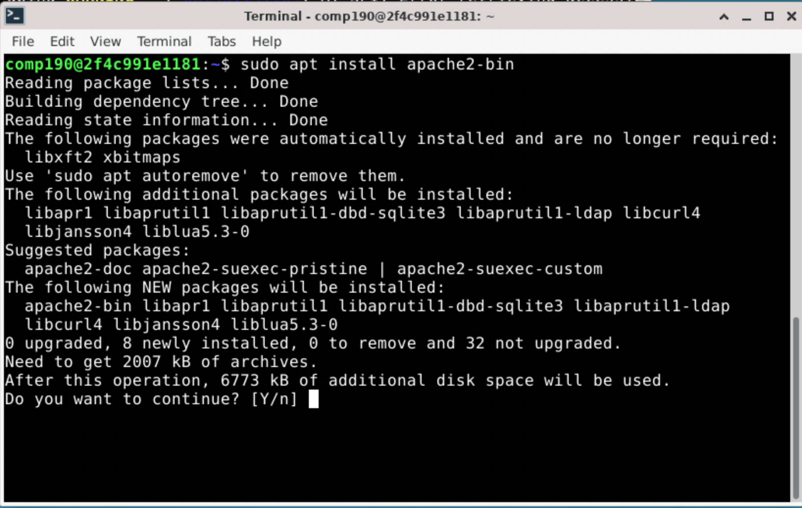
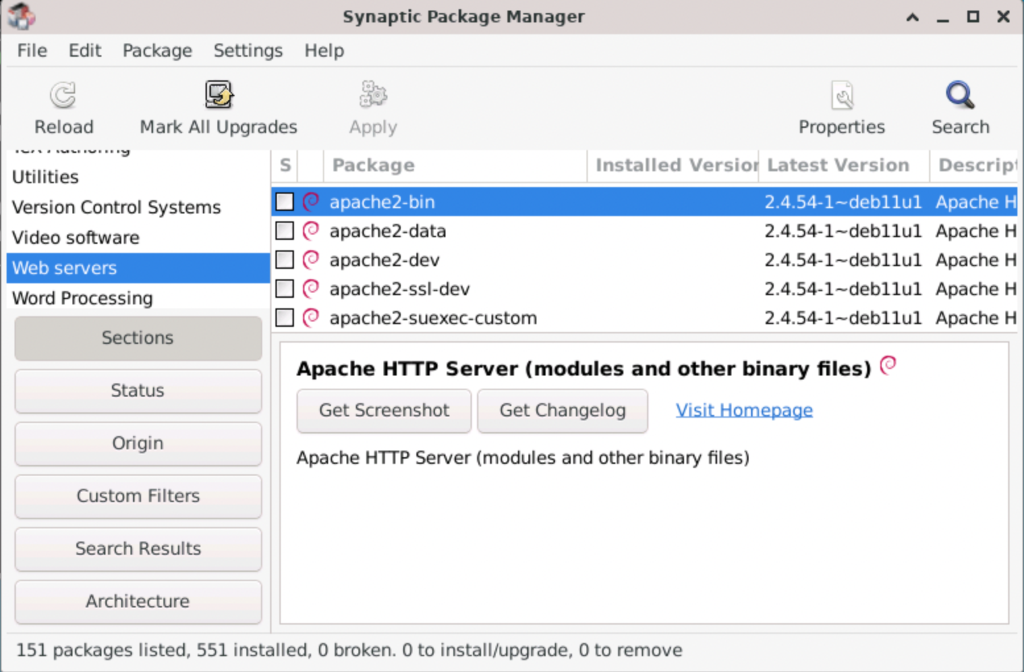
apt & Synaptic Package Manager
Notes:
Like CLI and GUI File manager …
APT and Synaptic are different interfaces to the same thing
APT is a command line tool
Synaptic Package Manger is a GUI too.

Slide 12
What’s Next?
Be sure to complete
Quiz 03
Complete HW 04
Submit to Moodle by next Wed 12:00 noon.
Complete Quiz 04
Do reading and prep for discussion.

Slide 13

Acknowledgments:
Slide Template From:
https://creativecommons.org/licenses/by/4.0/
Slide Content Licensed as:
https://creativecommons.org/licenses/by-nc/4.0/

